Slide 1
Geologic Dating
Integrated Science (H)

Slide 2
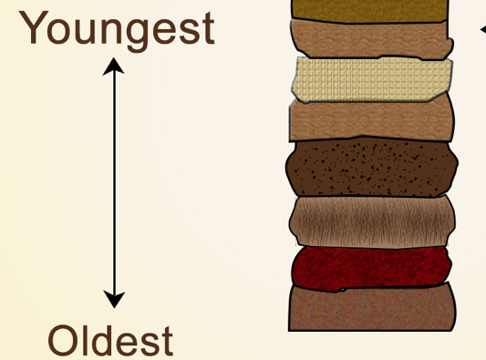
ESTABLISHING the age of ROCKS
Relative Dating “this rock is older than that one”
laws of superposition, horizontality, fossil info to interpret layering
Absolute Dating “this rock is 280 my old”
isotope ratios change in
radioactive decay
Notes:
O¹⁸ : O¹⁷

Slide 3
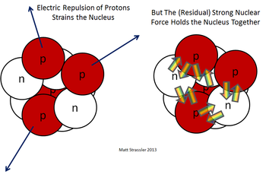
ABSOLUTE DATING relies on
RADIOACTIVE DECAY
Some isotopes of atoms have nuclei that are unstable
Due to the interactions of the strong nuclear force, and the repulsion of P+ in nucleus
Isotope? Atoms of an element that vary in # of neutrons
These atoms are radioactive
Naturally occur in igneous rock.
Notes:
1896-1898 Radioactivity discovered by: Henri Becquerel and Marie and Pierre Curie.
SNF ,is only at the shortest distances; EM radiation much greater distances
Therfeore, effect of the interaction of the two differs between large and small atoms

Slide 4
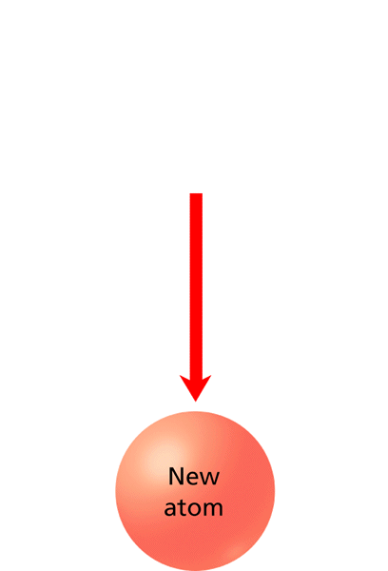
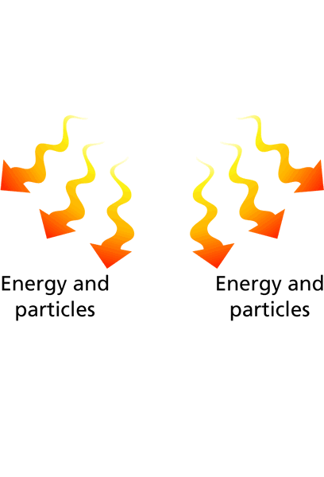
ABSOLUTE DATING relies on
RADIOACTIVE DECAY
They stabilize through decay - by ejecting particles and/or releasing energy
The decay rate is used to determine an absolute age
Notes:
1896-1898
Radioactivity discovered by:
Henri Becquerel and
Marie and Pierre Curie.

Slide 5
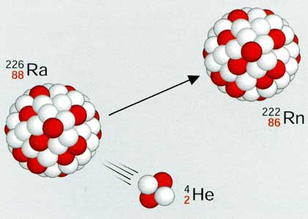
ALPHA Decay
Unstable nucleus ejects an alpha particle
2 protons, 2 neutrons
Damaging to tissues but does not cross skin
but: polonium 210 in cig smoke decays in lungs, implicated in cancer. Don’t smoke!
Radon, 86
Radium, 88
Net effect:
mass reduced by 4,
atomic number by 2

Slide 6
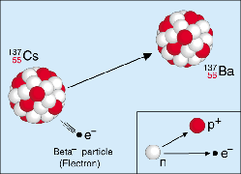
BETA Decay
Loss of a single (beta) particle
Ex: beta minus decay: neutron ejects an electron, leaving a proton behind
Penetrates skin, so damaging to cells, tissues
Radon, 86
Radium, 88
Net effect Beta minus decay:
+1 atomic number
no change in mass
Notes:
In beta plus decay, a proton decays into a neutron and positron (anti electron), positron then ejected. Still no mass change, but one less proton, so the number changes.
Also, double beta decay. double decay is the rarest phenomenon and theoretically 35 isotopes are capable of double beta decay but it is observed for only 12 of 35 isotopes.
And inverse beta decay

Slide 7
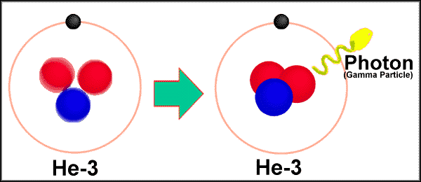
GAMMA DECAY
Energy released from excited nucleus
too much energy to be stable
often follows alpha, beta decay
High energy EM radiation penetrates deep into tissues
Stopped only by thick concrete, lead barriers
no change to atomic mass or number
Notes:
What happens to the apha, beta particles? They come togethe rto from harmless He

Slide 8
EXAMPLES
YOU TRY
Alpha decay
²³⁸U₉₂ →
²³⁴Th₉₀ + ⁴He₂
Beta decay
Alpha
¹⁸⁵Au₇₉ →
¹⁸¹Ir₇₇ + ⁴He₂
Beta
¹⁴C₆ →
¹⁴N₇ + e⁻
-
n
-
n
Notes:
¹⁸⁵Au₇₉ ------> ¹⁸¹Ir₇₇ + ⁴He₂

Slide 9
Can be COMPLEX!
Uranium 238 -> Lead 206

Slide 10
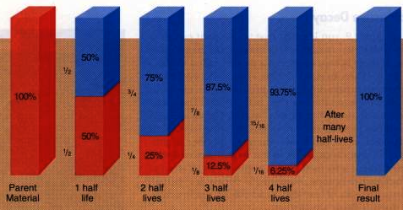
RATE of DECAY
As decay occurs, the isotope ratio changes
The amount of radioactive element – parent atom - goes down while the amount of decay product – daughter atom -goes up

Slide 11
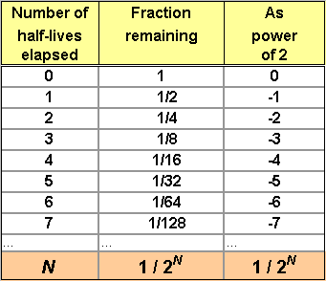
RATE of DECAY
The rate of decay for a specific element is constant
like a clock keeping perfect time
The rate is measured in half-life - the time it takes for half of the radioactive atoms to decay
Notes:
How is rate determined? By taking a large enough sample (were talking about atoms, so even a few grams is a large sample) and seeing how many decay in a second (use a geiger counter). The decay of radioactive elements is constant so, if one were able to measure how much decay occurred in 10 seconds, one could deduce how much decay will occur in 10 years. Or in 730 million years.
The measurement is useful, because exponential decay means “it doesn’t matter how much radioactive material you have, the time taken until half of it is gone [the half-life] is always the same.”
The whole life of the material, on the other hand, would be equal to the lifespan of the last atom in the group to decay. Since an atom’s lifespan is random, inestimable and essentially infinite, the whole life would be, too. It winds up being a not-very-useful measurement.

Slide 12
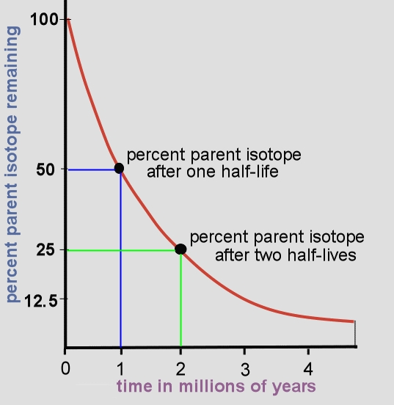
What is the half life of this isotope?

Slide 13
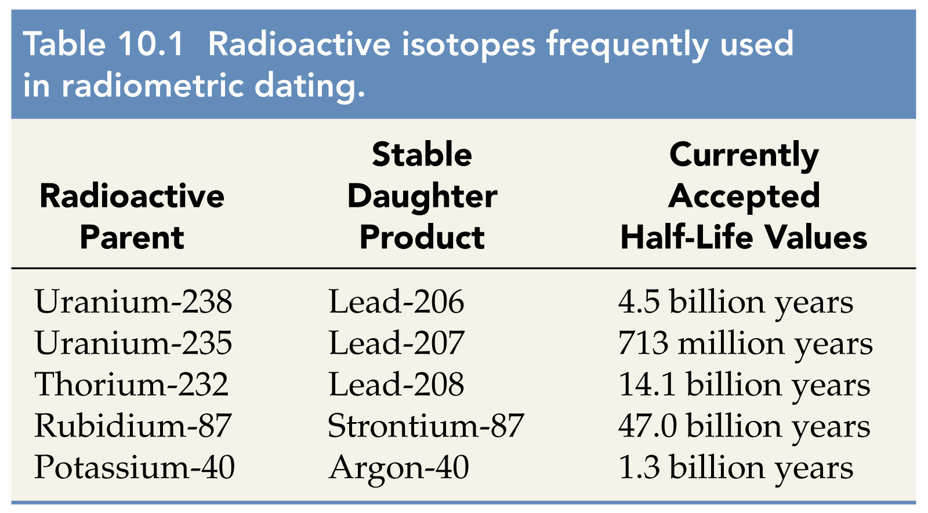
Half-LiFE of Radioactive Isotopes
useful isotopes for rocks, but too long half-life to use on tissues
Notes:
It is one of the funny things of the theory of probability that you need not have to wait for that long to confirm the half life. For example it has been estimated that proton has a half life of approximately 1032 years in some grand unified theories. Now in order to observe proton decay one does not have to wait for 1032 years. You just take some material which has 1032 numbers of protons. According to the theory of probability you should observe at least one proton decay per year (if a proton doest indeed take 1032 years to decay). For an easier example, suppose you throw a dice 6 times. The probability of a particular outcome is same or equivalent to throwing 6 dices at once.

Slide 14
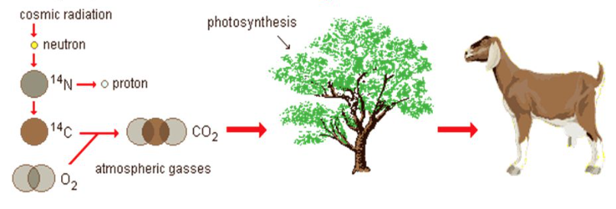
Carbon 14 Dating
Useful for dating plant and animal remains from 500 to 50,000 years old soft tissue, wood, bone, cloth
¹⁴C in atmosphere forms CO_{2,} taken up in PSN
When the organism dies, no more ¹⁴C taken in; ¹⁴C already present decays into ¹⁴N
Notes:
Carbon-14 is produced in the upper layers of the troposphere and the stratosphere by thermal neutrons absorbed by nitrogen atoms.
Plants take in atmospheric carbon during photosynthesis, so the level of ¹⁴C in plants and animals when they die approximately equals the level of ¹⁴C in the atmosphere at that time. However, it decreases thereafter from radioactive decay, allowing the date of death or fixation to be estimated.
The initial ¹⁴C level for the calculation can either be estimated, or else directly compared with known year-by-year data from tree-ring data (dendrochronology) up to 10,000 years ago (using overlapping data from live and dead trees in a given area), or else from cave deposits (speleothems), back to about 45,000 years before the present.
A calculation or (more accurately) a direct comparison of carbon-14 levels in a sample, with tree ring or cave-deposit carbon-14 levels of a known age, then gives the wood or animal sample age-since-formation.

Slide 15
Isotope DECAY: Math Practice
⁵⁶Cr₂₄ -> e⁻ + _______ α or β?
²⁰⁸Po₈₄ -> ⁴He₂ + ______ α or β?
¹³¹I₅₃ -> ¹³¹Xe₅₄ + ______ α or β?
²⁴¹A₉₅ -> ²³⁷Np₉₃ + ______ α or β?
²³⁸Ur₉₂ undergoes an α decay – write the complete equation

Slide 17
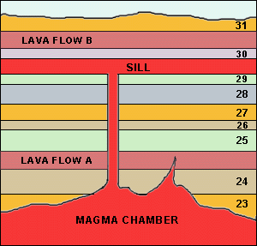
Date the igneous intrusions to date the layers
Youngest
Older
Oldest
Use radiometric* dating of the igneous as ‘bookmarks’ to date the sedimentary layers
*radioisotope; absolut)
Notes:
It is important to understand that the age of a sedimentary layer (bed, formation, etc.) is NOT the age of the particles that compose the rock.
we have many sedimentary rock units that are only a few million years old, or less, but that nevertheless contain particles (small rock fragments or mineral grains) that are over 100 million years old. It is the laying-down of the sediment that counts, not the age of the particles.

Slide 18
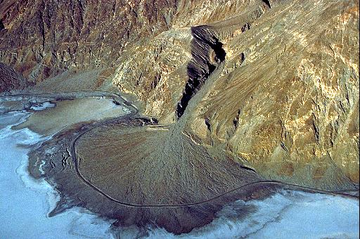
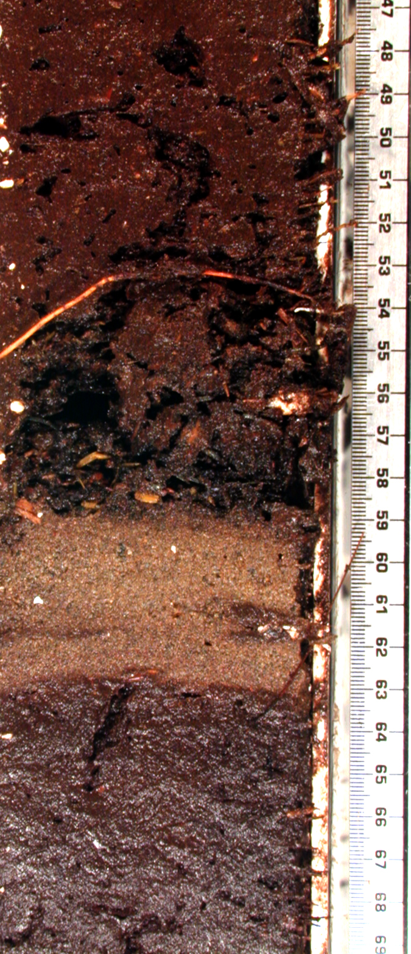
Dating Sedimentary Layers
The age of a layer reflects when the particles were laid down; the particles themselves were formed earlier
100mya
2mya
A layer formed 2mya could contain rock bits formed 100mya
2mya
Notes:
It is important to understand that the age of a sedimentary layer (bed, formation, etc.) is NOT the age of the particles that compose the rock.
we have many sedimentary rock units that are only a few million years old, or less, but that nevertheless contain particles (small rock fragments or mineral grains) that are over 100 million years old. It is the laying-down of the sediment that counts, not the age of the particles.

Slide 19
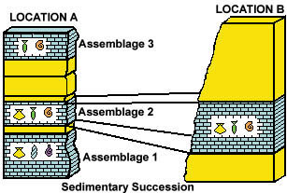
Date the igneous intrusions to date the layers
Igneous
Sedimentary
igneous
< 65my
65my
>95my
95my
Notes:
It is important to understand that the age of a sedimentary layer (bed, formation, etc.) is NOT the age of the particles that compose the rock.
we have many sedimentary rock units that are only a few million years old, or less, but that nevertheless contain particles (small rock fragments or mineral grains) that are over 100 million years old. It is the laying-down of the sediment that counts, not the age of the particles.

