Slide 1
Universal GRAVITY
Misconceptions
IntegratedScience c/d

Slide 2
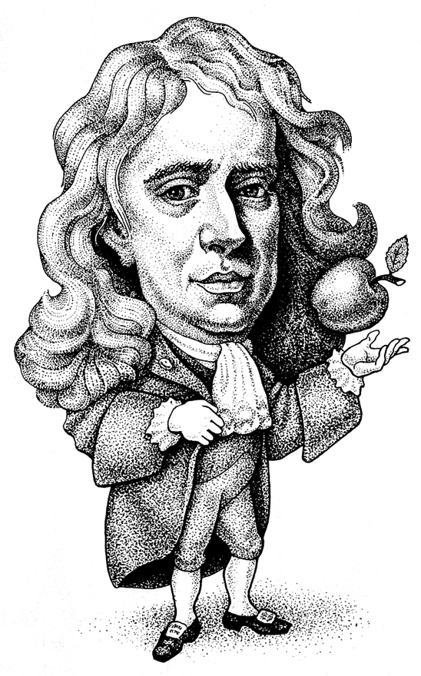
Newton: Thinking Further
Gravity is not restricted to objects falling to Earth
Every object in the universe exerts a gravitational force on everything else
aka Universal Gravitation
Isaac Newton
MinutePhysics

Slide 3
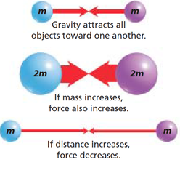
g-Force VariableS
The masses of the objects
greater masses have a greater g-force between them.
A proportional relationship
The distance between the masses
at greater distances, force between masses is lower
An inversely proportional relationship

Slide 4
The Formula
As a proportion:
mass 1 • mass 2
g Force ~ ---------------------
distance²
As an equality:
m1 • m2
Force = (G constant) ------------
d²
TED Ed

Slide 5
The effect of DISTANCE on g
How much area the force is spread out over
The power/intensity of the force per unit of area
Pattern:
At greater distances, the effect of the force is spread out over a larger area
How much more area? How much is the force reduced per unit area? Use the Law!

Slide 6
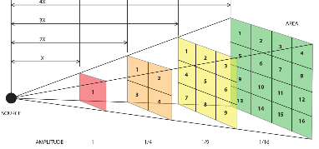
The effect of distance reflects
the inverse square law
Describes the relationship between distance, area, and intensity
i = 1/d²
Governs g-force, as well as light (in lab), radiation, paint, even butter!
iIllumination per unit
predicts area covered

Slide 7
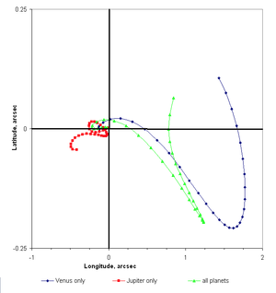
Universal Gravitation: EVIDENCE
• Elliptical Orbits
> speed increases as planet approaches the sun animation
> closer planets orbit faster animation
• Wobble in orbital path as distances between two planets change
Mercury (0,0) orbit perturbed by Venus Jupiter, all planets
Notes:
Mercury's orbital longitude and latitude, as perturbed by Venus, Jupiter and all of the planets of the Solar System, at intervals of 2.5 days. Mercury would remain centered on the crosshairs if there were no perturbations.

Slide 8
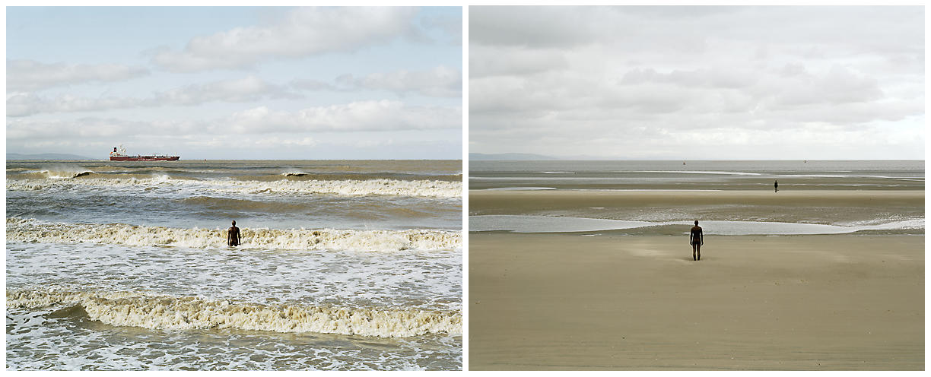
Universal Gravitation: EVIDENCE
• Tides - from the g-force between Earth and the Moon (and to a lesser extent, the Earth and Sun)
Notes:
Mercury's orbital longitude and latitude, as perturbed by Venus, Jupiter and all of the planets of the Solar System, at intervals of 2.5 days. Mercury would remain centered on the crosshairs if there were no perturbations.

Slide 10
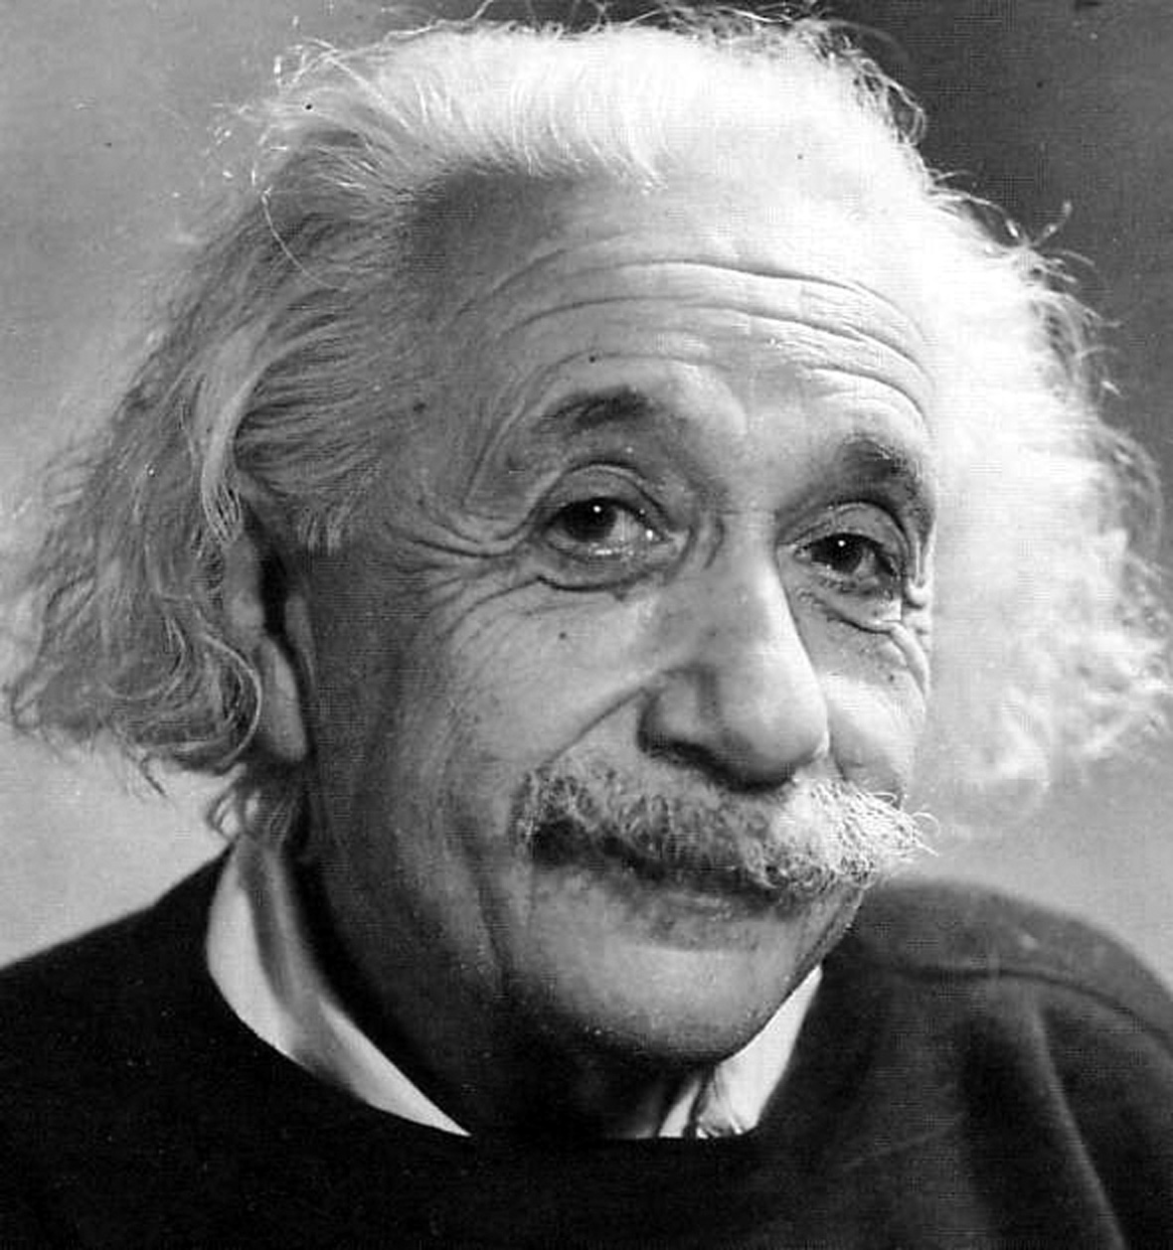
Enter einstein
Newton explained that gravity is why satellites (planets, etc) orbit
Einstein’s question: 'what is gravity?’
not a force
a falling man does not experience any ‘force’ until he hits the ground
Instead, gravity is a consequence of the "shape" of the universe.
http://www.youtube.com/watch?v=4yyb_RNJWUM (at 1:55 min)
Notes:
General relativieyt brings together special relativity, newtonian motion, and

Slide 11
General Relativity THEORY
• Space is the ‘fabric ‘ of the universe
• the 4th dimension, aka spacetime
Objects in space affect the geometry of the fabric
More massive bodies curve spacetime more
Nearby bodies follow the curve
Gravity is an artifact of this curvature
Notes:
In non-relativistic classical mechanics, the use of Euclidean space instead of spacetime is appropriate, as time is treated as universal and constant, being independent of the state of motion of an observer. In relativistic contexts, time cannot be separated from the three dimensions of space, because the observed rate at which time passes for an object depends on the object's velocity relative to the observer and also on the strength of gravitational fields, which can slow the passage of time.
Until the beginning of the 20th century, time was believed to be independent of motion, progressing at a fixed rate in all reference frames; however, later experiments revealed that time slows at higher speeds of the reference frame relative to another reference frame. Such slowing, called time dilation, is explained in special relativity theory.
General relativieyt brings together special relativity, newtonian motion, and spacetime

Slide 12
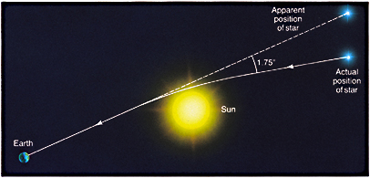
Evidence: Gravitational Lensing
Light bends as it passes stars & galaxies
Confirmed 1919 eclipse
Analgous to the bending of light as it passes through water, or a prism
Notes:
The perihelion precession of Mercury was the first evidence that general relativity is correct. Sir Arthur Stanley Eddington's 1919 expedition in which he confirmed Einstein's prediction for the deflection of light by the Sun during the total solar eclipse of 29 May 1919 helped to cement the status of general relativity as a likely true theory. Since then many observations have confirmed the correctness of general relativity. These include studies of binary pulsars, observations of radio signals passing the limb of the Sun, and even the GPS system.
Both Newton's old theory of gravity, and Einstein's new one predicted that light does not necessarily travel in straight lines, but can be deflected when it passes something as heavy as the sun. However, Einstein predicted that it bent more: enough for the apparent positions of stars behind the sun to detectably shift, compared to their known, true positions.
When astronomers refer to lensing, they are talking about an effect called gravitational lensing. Normal lenses such as the ones in a magnifying glass or a pair of spectacles work by bending light rays that pass through them in a process known as refraction, in order to focus the light somewhere (such as in your eye).
Gravitational lensing works in an analogous way and is an effect of Einstein's theory of general relativity – simply put, mass bends light. The gravitational field of a massive object will extend far into space, and cause light rays passing close to that object (and thus through its gravitational field) to be bent and refocused somewhere else. The more massive the object, the stronger its gravitational field and hence the greater the bending of light rays - just like using denser materials to make optical lenses results in a greater amount of refraction.
The new findings come from a study of light from hundreds of thousands of distant galaxies. General relativity predicts that the wavelength of this light will be shifted by a small amount due to the galaxies' mass, in an effect called gravitational redshift.

Slide 13
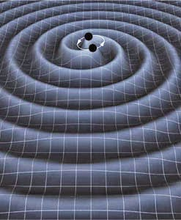
Evidence: Gravitational Waves
Ripples that radiate outward from a source
Observable when two very dense objects (neutron stars, black holes) orbit one another, merge
2015: a pair of black holes, (29x & 36x the sun) merged, producing detectable gravitational ripples
3 more detected since then
Notes:
The perihelion precession of Mercury was the first evidence that general relativity is correct. Sir Arthur Stanley Eddington's 1919 expedition in which he confirmed Einstein's prediction for the deflection of light by the Sun during the total solar eclipse of 29 May 1919 helped to cement the status of general relativity as a likely true theory. Since then many observations have confirmed the correctness of general relativity. These include studies of binary pulsars, observations of radio signals passing the limb of the Sun, and even the GPS system.
Both Newton's old theory of gravity, and Einstein's new one predicted that light does not necessarily travel in straight lines, but can be deflected when it passes something as heavy as the sun. However, Einstein predicted that it bent more: enough for the apparent positions of stars behind the sun to detectably shift, compared to their known, true positions.
When astronomers refer to lensing, they are talking about an effect called gravitational lensing. Normal lenses such as the ones in a magnifying glass or a pair of spectacles work by bending light rays that pass through them in a process known as refraction, in order to focus the light somewhere (such as in your eye).
Gravitational lensing works in an analogous way and is an effect of Einstein's theory of general relativity – simply put, mass bends light. The gravitational field of a massive object will extend far into space, and cause light rays passing close to that object (and thus through its gravitational field) to be bent and refocused somewhere else. The more massive the object, the stronger its gravitational field and hence the greater the bending of light rays - just like using denser materials to make optical lenses results in a greater amount of refraction.
The new findings come from a study of light from hundreds of thousands of distant galaxies. General relativity predicts that the wavelength of this light will be shifted by a small amount due to the galaxies' mass, in an effect called gravitational redshift.
(as recent as 9/17)

Slide 14
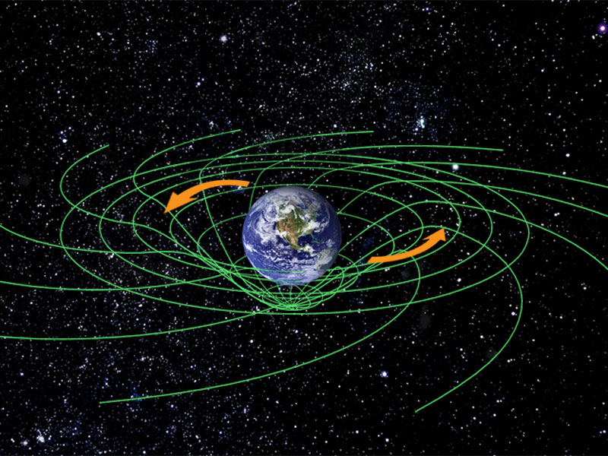
EVIDENCE: Frame Dragging
Rotating bodies drag spacetime along with them (space is twisted!)
Evident as shifts in the planes of the orbits of satellites
http://www.pbs.org/wgbh/nova/einstein/hotsciencetwin/
For fun (on your own)
http://www.pbs.org/wgbh/nova/time/think.html
Notes:
bending light rays that pass through them in a process known as refraction, in order to focus the light somewhere (such as in your eye).
Any object with mass warps the space-time around it, in much the same way as a heavy object deforms a stretched elastic sheet, explained study leader Ignazio Ciufolini of the Universit? di Lecce in Italy.
If the object spins, another distortion is introduced, "in the same way as the elastic sheet would be twisted by a spinning heavy wheel on it."
If the space around Earth is being frame-dragged, then satellites ought to be caught up in the deformation, scientists reasoned. Imagine how a second object on the elastic sheet would be moved by the scrunching motion created as the sheet is deformed.

